Slide 1
Automated transport control system

Slide 2

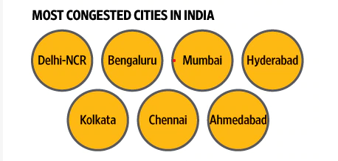
Do yoU know?
Every year due to peak hour traffic congestion majorly in the metropolitan cities of India, our economy is affected by a loss of 1.5 lakh crores.
The average time wasted in the traffic congestion of an average Indian counts to around 1 hour daily.
Wasted fuel at traffic lights increases air pollution and carbon dioxide emissions.

Slide 3
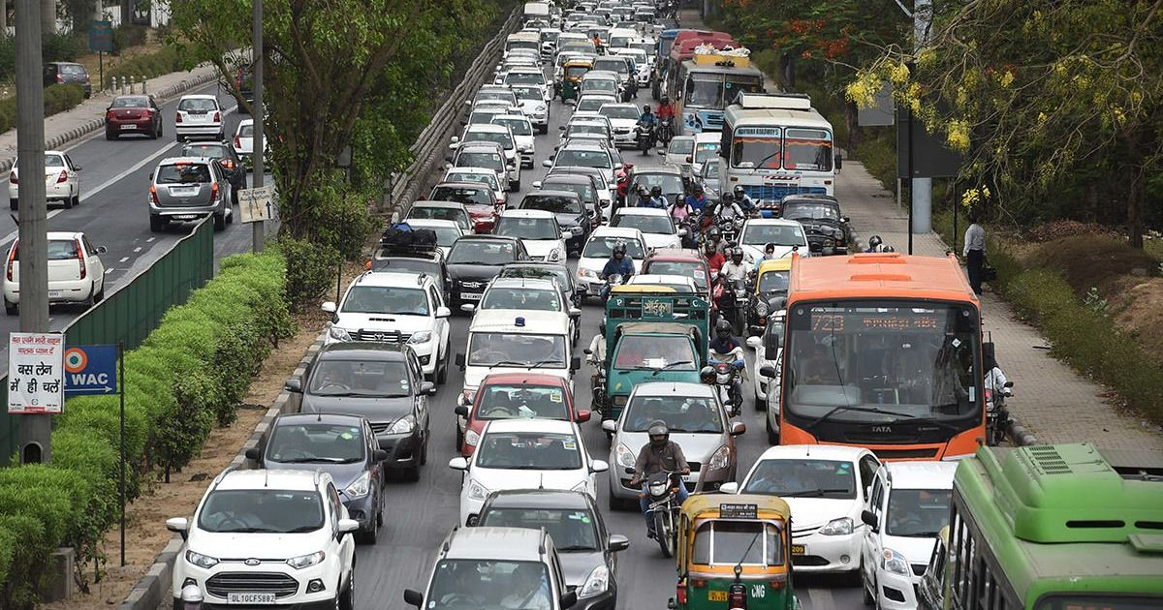
Proposed idea
Main Idea
Dynamic Traffic Control
Add-Ons
Automated Traffic Rule Violation Detection
Automated Issue of E-challan
Real Time Route Redirection

Slide 4
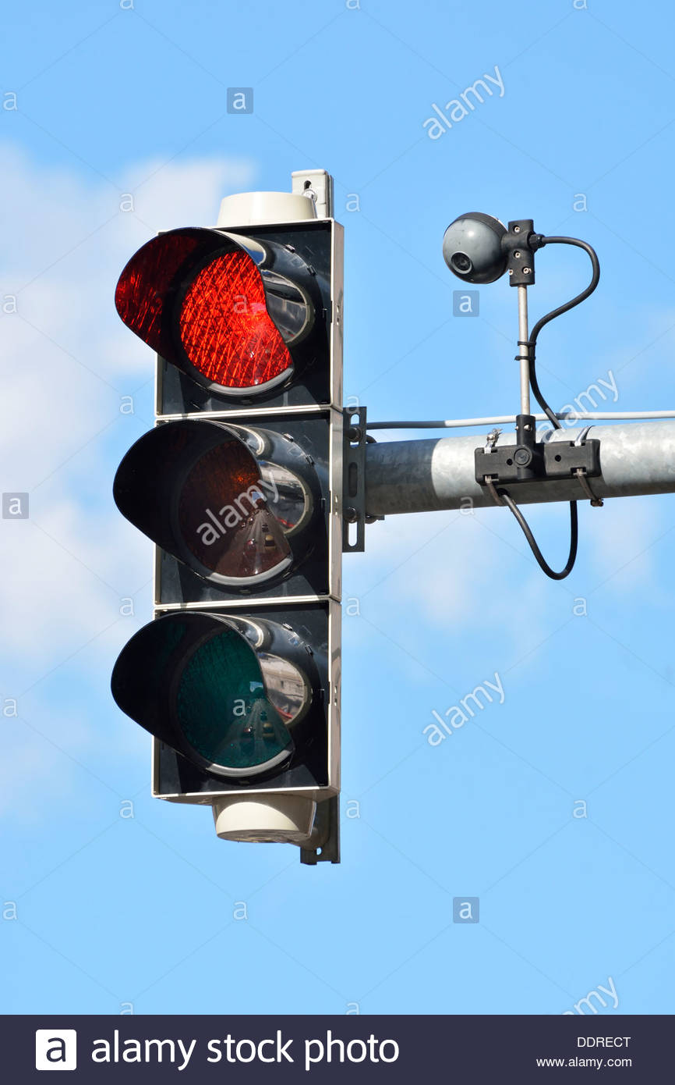
Technology stack
A high resolution image capturing device with high frame rate(fps) and wide viewing angle.
Node.js along with express, jimp and pixel-match packages for image processing.
Image processing and background subtraction to find out the best traffic control dynamically.

Slide 5
Use cases
Optimized traffic control system
Reduced number of traffic rule violators
Faster response time in various circumstances
Increased fine generation
Reduction in the number of bribes

